Slide 1
Machine learning
Regent College London
SWE6204

Slide 2
Machine learning
SWE6204

Slide 3

Machine learning
ML MODEL VALIDATION
TECHNIQUE

Slide 4
Module 1 – MACHINE LEARNING MODEL VALIDATION TECHNIQUE

Slide 5
Learning objectives
Understand ML Evaluation Metrices
Understand the Accuracy
Understand the Confusion Matrix
Understand AUC

Slide 6
ML evaluation metrices
Methods which determine an algorithm’s performance and behavior
Helpful to decide the best model to meet the target performance
Helpful to parameterize the model in such a way that can offer best performing algorithm
Various types of ML Algorithms (classification, regression, ranking, clustering)
Different types of evaluation metrics for different types of algorithm
Some metrics can be useful for more than one type of algorithm (Precision - Recall)

Slide 7
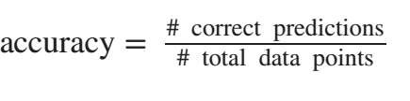
Accuracy
Ratio between the number of correct predictions and total number of predictions
Example: Suppose we have 100 examples in the positive class and 200 examples in the negative class. Our model declares 80 out of 100 positives as positive correctly and 195 out of 200 negatives as negative correctly.
So, accuracy is = (80 + 195)/(100 + 200) = 91.7%

Slide 8
Confusion matrix
Shows a more detailed breakdown of correct and incorrect classifications for each class.
Think about our previous example and then the confusion matrix looks like:
What is the accuracy that positive class has ? And Negative class?
Clearly, positive class has lower accuracy than the negative class
And that information is lost if we calculate overall accuracy only.
 | Predicted as positive | Predicted as negative
Labeled as positive | 80 | 20
Labeled as negative | 5 | 195

Slide 9
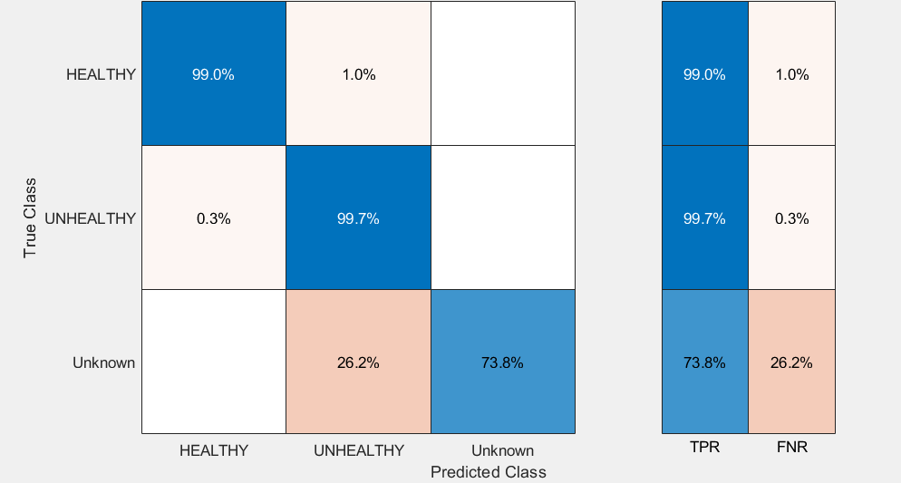
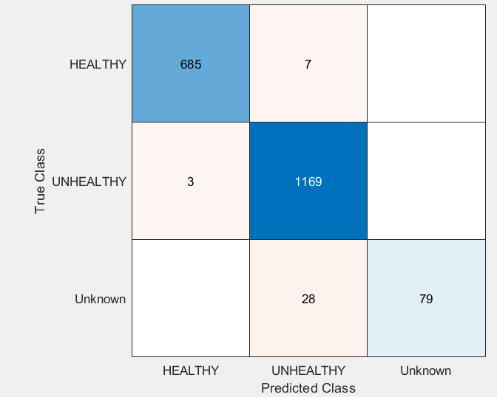
Confusion matrix

Slide 10
Per-class accuracy
Average per class accuracy of previous example:
(80% + 97.5%)/2 = 88.75 %, different from accuracy
Why important?
Can show different scenario when there are different numbers of examples per class
Class with more examples than other will dominate the statistic sof accuracy, hence produced a distorted picture

Slide 11
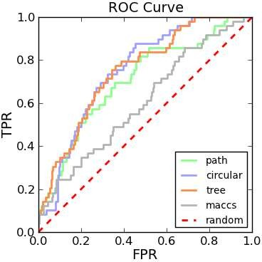
AUC – Area under curve
The curve is receiver operating characteristic curve or in short ROC curve
Provides nuanced details about the behaviour of the classifier
Bad ROC curve covers very little area
Good ROC curve has a lot of space under it
ROC curve visualizes all possible classification thresholds, whereas other metrics only represents your error rate for a single threshold

Slide 12
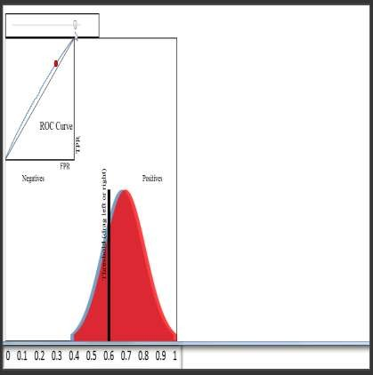
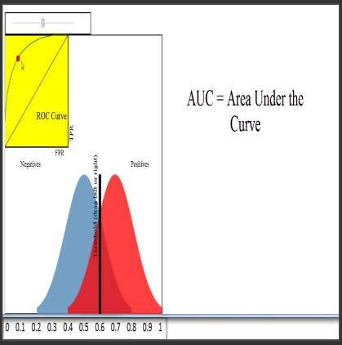
Auc- (Contd..)

Slide 13
Ranking metrics
Precision – Recall
Precision – Recall curve and F1 Score

Slide 14
Calculation example of Precision - recall
Precision = TP / (TP+FP)
= 60 / (60 + 140) = 30%
Recall = TP / (TP+FN)
= 60 / (60+40) = 60%
Total Negative = 9760 + 140 = 9900
Total Positive = 40 + 60 = 100
Total Negative prediction = 9760 + 40 = 9800
Total Positive prediction = 140 + 60 = 200
 | Predicted as Negative | Predicted as Positive
Actual Negative | 9760 (TN) | 140 (FP)
Actual Positive | 40 (FN) | 60 (TP)

Slide 15

F- Measure
One measure of performance that takes into account both recall and precision
Harmonic mean of recall and precision:
Compared to arithmetic mean, both need to be high for harmonic mean to be high

Slide 16
+44 (0)207 016 8000
info@rcl.ac.uk

